Slide 1

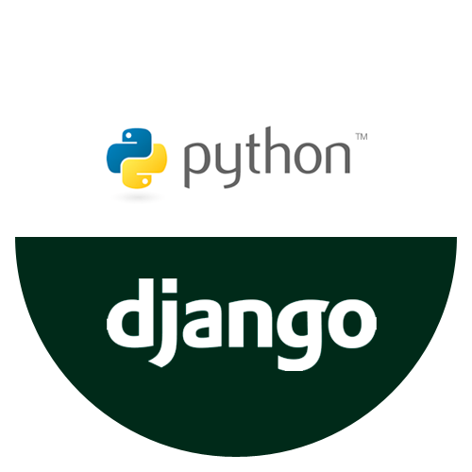
Internship in Python with Django
I completed a 1-month internship at Revolution IT Solutions in Python with Django. The main objective was to gain hands-on experience in applying Python with Django techniques to real-world industry problems.
- By Shivani Mali.

Slide 2
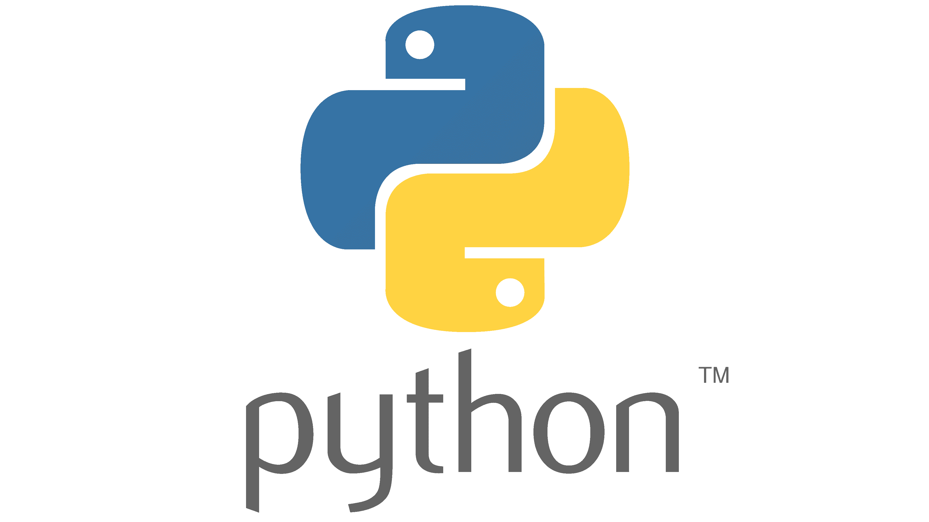
Introduction:
Python with Django
Django is a high-level Python web framework that helps developers create web applications quickly and with a clean, straightforward design. Python, known for its simplicity and readability, is a versatile programming language used in everything from web development to data analysis and artificial intelligence. Django builds on Python’s strengths, simplifying the process of building secure and scalable web apps. By learning Django, developers can fully use Python’s power for web development, making it easy to create strong and dynamic websites.

Slide 3

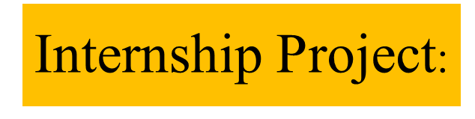

1
Project Overview:
Objective: Develop a "Personal Bill Tracker" using Python to help users manage and track their expenses efficiently.
Scope: The application includes functionalities such as bill entry, expense categorization, and summary reports.
Target Users: Individuals or small businesses needing an efficient way to manage bills and monitor spending.
Timeline: The project was completed over the course of my internship.
2
Problem Statement:
Issue: Managing multiple bills and tracking expenses can be challenging.
Impact: Leads to potential overspending or missed payments.
Challenges: Integrating different bill formats and automating expense categorization.
3
Model Implementation:
Framework: Python, chosen for its simplicity.
Design: Modular structure for easy updates.

Slide 4
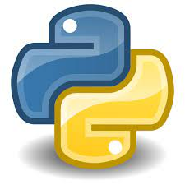

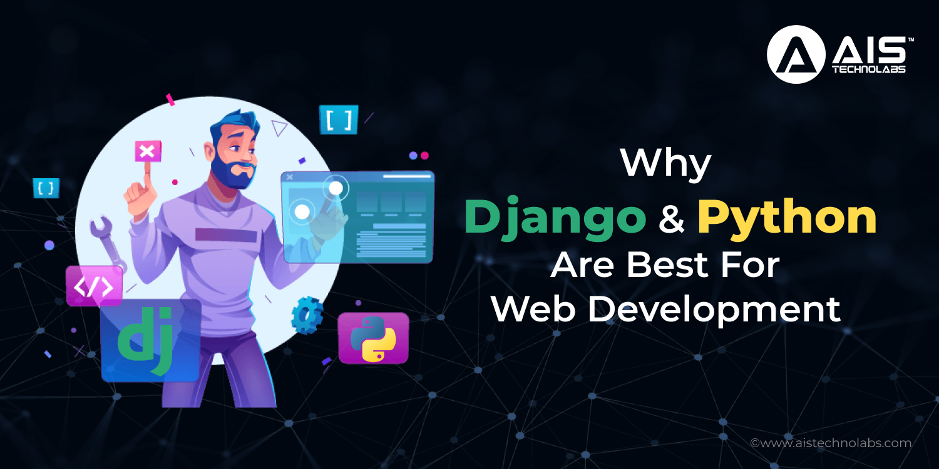

Methodology and implementation
Data Handling:
It involves gathering data from various sources such as databases and user inputs. Once collected, the data is cleaned to remove any errors and inconsistencies, making it organized and ready for use within Django.
Model Development:
is the next step, where database structures are defined using Django’s models. This process also includes optimizing the models and algorithms to ensure the application performs efficiently.
Deployment:
It comes last, where the application is launched using tools like Docker. Post-deployment, the application's performance is monitored to ensure it runs smoothly and meets the necessary requirements.

Slide 5






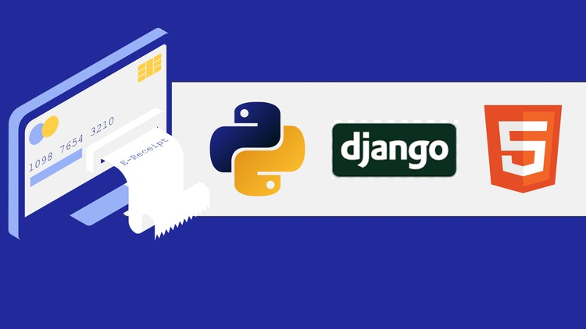




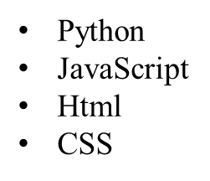
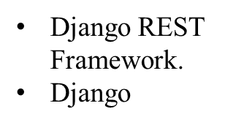
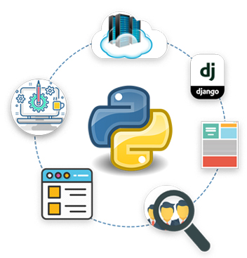


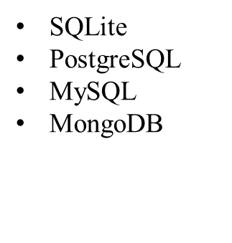
4
Development Tools:
Git
Visual Studio Code
ChatGPT

Slide 6

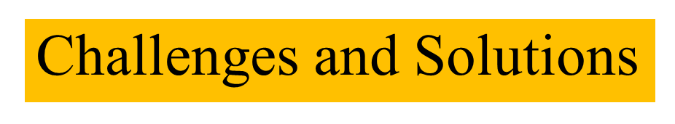
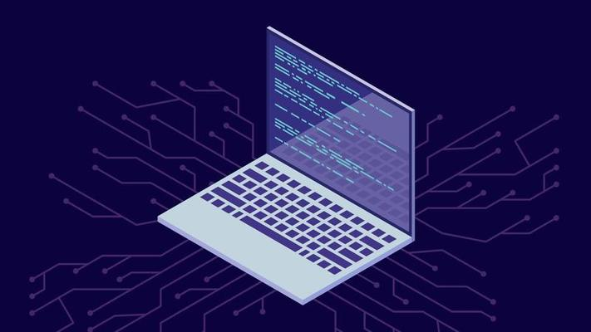

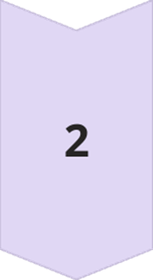



Debugging Complex Code:
Solution: I encountered unexpected errors in the application. By using debugging tools and carefully analyzing the code, I identified and fixed the issues, improving my problem-solving skills.
Working with Databases:
Solution: Had difficulty integrating Django with complex databases. Optimized queries and models, leading to better data management.
Managing Time and Multiple Projects:
Solution: Balancing multiple tasks and deadlines during the internship was a significant challenge. I developed a structured approach by prioritizing tasks and using project management tools, which improved my time management skills and ensured timely completion of all projects.

Slide 7
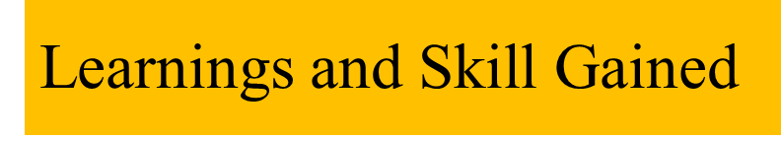
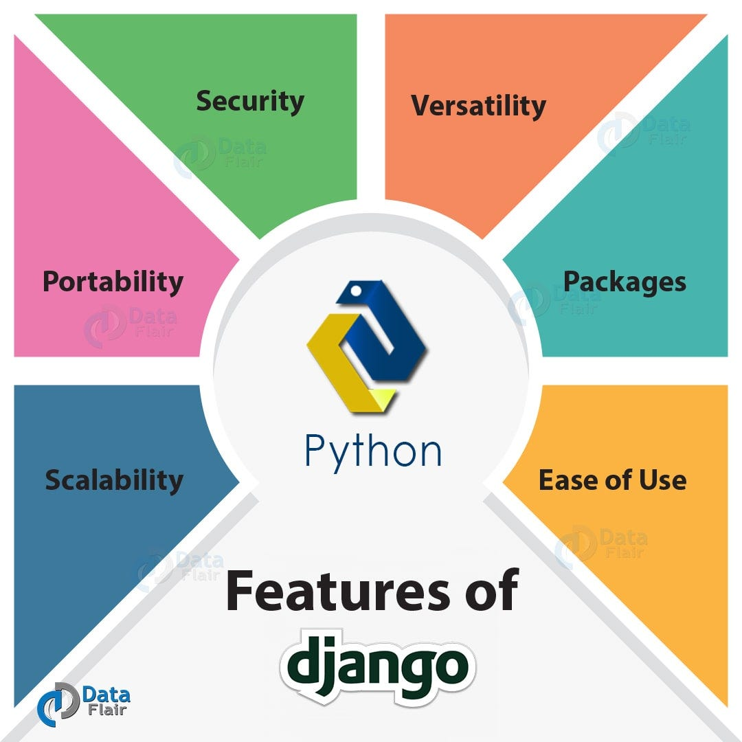




Python Proficiency:
Web – Page Development:
Deepened understanding of Python, including advanced topics like object-oriented programming, exception handling, and file management.
Acquired hands-on experience in developing web pages and applications using Django, including project setup, views, templates, and database management.
Problem solving skills:
Communication skills:
Improved teamwork and communication through regular interactions with colleagues, project discussions, and collaborative problem-solving.
Enhanced ability to debug and troubleshoot issues, applying effective solutions to real-world challenges in a Django environment.

Slide 8





Internship Impact
Skill Enhancement: Acquired practical skills in Python and Django, including advanced concepts like object-oriented programming and web development frameworks. Problem-Solving: Overcame challenges by debugging complex issues and implementing effective solutions, strengthening my problem-solving abilities.
Project Contribution: Contributed to a web application project, improving user engagement and gaining hands-on experience with real-world applications.
Professional Growth: Developed teamwork and communication skills through regular interactions with supervisors.
Networking: Built valuable connections with industry professionals, providing potential future career guidance and opportunities.

Slide 9
Future Opportunity
Career Path: Inspired to pursue a career as a web developer or backend engineer, leveraging the Django and Python skills gained.
Skill Application: Plan to use my Django knowledge in future projects and contribute to open-source initiatives updated.
Further Learning: Interested in exploring advanced Django features and emerging web technologies to stay Professional Goals: Aiming for roles in tech companies to continue developing programming skills and tackle challenging projects.
Industry Trends: Observed the increasing focus on data security in web development, which will influence my future career focus.

Slide 10
Thank you….

